Slide 1
Welcome to CIS Orientation
The session Will begin Shortly

Slide 2
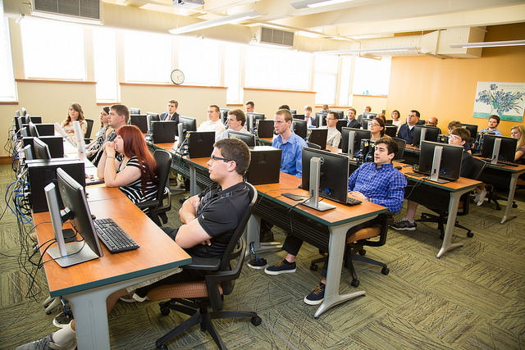
Academic Orientation 2023
Computing & Information Systems Department
http://cis.stvincent.edu
Saint Vincent College

Slide 3
CIS Faculty
Dr. Anthony Serapiglia, Chair
Anthony.Serapiglia@stvincent.edu
Dr. William Birmingham
William.Birmingham@stvincent.edu
Br. David Carlson
David.Carlson@stvincent.edu
Dr. Stephen Jodis, Dean of the Boyer School
Stephen.Jodis@stvincent.edu

Slide 4
CIS Majors
Majors
Computer Science
Information Systems
Cybersecurity

Slide 5
Classroom and Offices
Nearly all CIS classes are taught in Dupre W214
Faculty Offices are right around the corner
Faculty have regularly scheduled office hours
Faculty are often available outside those hours
CIS Students work in W214 and the Dupre common areas
Easy access to faculty and other students
Access to computers (in W214)

Slide 6
Important Items
Important dates
28 August: First Day of Class
8 December: Last Day of Class
Finals: Begin Dec 11
During the 1st week of the Term, meet with your Faculty Advisor!

Slide 7
Schedule
First-semester schedule is similar for all CIS majors
Programming Core
CS 102
CS 110 (CS 111 for students with CS110 credit)
Core – 1400/1500 plus…
Math
Typical Schedule is 14 – 17 Hours
Most classes are three credits: three lectures per week
Labs and some other classes have a different accounting

Slide 8
Schedule
Most of your time is not in class
Common to have blocks of time with no classes during the Day
Common to have days with more classes than other days
How you spend your time will determine how well you do
Faculty assume two-to-three hours of work outside class per credit hour
Three-credit course: six-to-nine hours of work
Five Class Load: 30-45 hours per week in studies
The first two weeks of the semester are not typical

Slide 9
Schedule
The Department Website has lots of useful information: cis.stvincent.edu
Tentative schedule of class offerings: https://cis.stvincent.edu/cis/DeptInfo/FutureCourseOfferings.php

Slide 10
Schedule
Outside the classroom
We highly encourage Athletics, Music, Theater, IM Sports, Clubs, …
Games, Practices, Travel: Faculty will work with you to accommodate
GET INVOLVED!!!!
Special Accommodations
College Office
Faculty will work with you to accommodate

Slide 11
Academic success
Most Important Principle: Learn the material and grades will follow.
Corollary: Do not worry about grades, it is outside your control.
Four Principles:
Time Management
Read the Textbook, do the Homework and Projects
Keep up with the class. DO NOT CRAM!!!!
Seek help IMMEDIATELY
Faculty
Tutors
Upperclassmen

Slide 12
Transition to College
Living away from home can be a difficult transition
Lots of changes: New school, Roommates, Pace of college life
Some students have no problem, Some students have problems
If you do experience problems, Know you will get through
ASK! The greatest sign of growth in your first year is when you begin to ask for help. Life is so much easier when you stop beating your head against the wall and simply ask for help!
Most important thing: Stay the course – Trust yourself – Trust us

Slide 13
Transition to College
Meaningful words:
Scientists – you are in a school of Natural Sciences! Be a Scientist!
Thoughtful
Curious
Perseverant
Organized
Compassionate – with yourself and others
Independent – success is up to you. Control your destiny.
Open – to new ideas, to guidance, to constructive criticism
Willing – to be a leader, to go a step further, to challenge yourself…
There is value in frustration – you value things you have to work hard for.

Slide 14
Workstudy Jobs
The CIS Department hires students as tutors in our computer lab, though sophomores through seniors are preferred.
The Information Technology department hires students for technology work. Prior experience helps.
Increasingly, our students are finding jobs in Junior and senior year and working while finishing their degree. A lot of this flows from good internship experiences!
But remember – first things first – you are a student first and the primary objective is that degree!

Slide 15
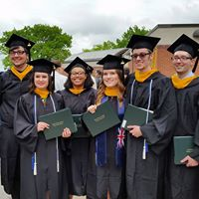
The Saint Vincent Advantage:
Small classes where you get to know your professors and fellow students
CIS classes usually have a maximum of 25
Most CIS classes range from about 5 to 18
Faculty who work hard to assist you
Extra opportunities provided by research and projects
A Liberal Arts foundation that allows you to take full advantage of your technical skills

